Slide 1
Introduction to Graphs
Chapter 15

Slide 2
The chapter focuses on topics like
1.A Bar graph
2.A Pie graph
3.A histogram
4. A line graph
5.Linear graph
6.Locate a point

Slide 4
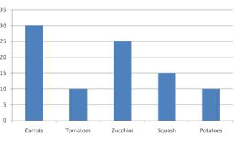
Bar graph
A bar graph is used to show a comparison among categories. It may contain parallel vertical or horizontal bars or rectangles.

Slide 5
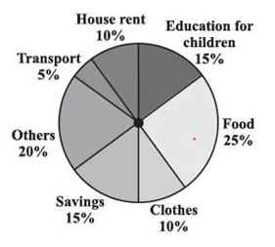
Pie graph
A pie graph is used to compare parts of a whole. It is also referred to as circle graphs.

Slide 6
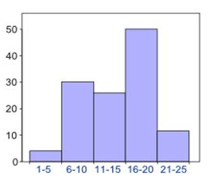
Histogram
A histogram is a bar graph that shows data in intervals. It consists of adjacent bars over the intervals.

Slide 7
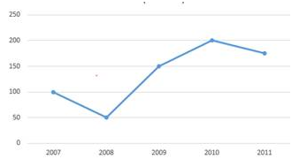
Line graph
A line graph displays data that change continuously over periods of times

Slide 8
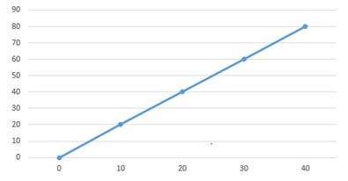
LINEAR GRAPH
A line graph which is a whole unbroken line is called a linear graph.

Slide 9
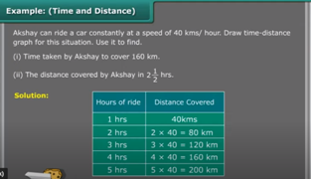

Slide 12
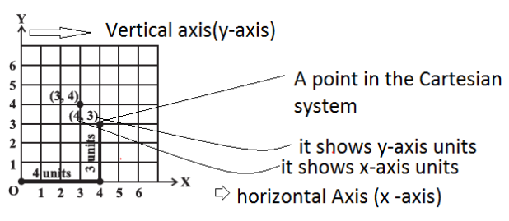
CARTESIAN SYSTEM
The system of fixing a point with the help of two measurements, vertical and horizontal is known as Cartesian system

Slide 13
Important points
(1) The horizontal axis is called X-axis (2) The vertical axis is called the Y-axis (3) O is the origin (4) Any point is depicted by distance from both the axis (5) The horizontal distance is called the x-coordinate (6) The vertical distance is called the y -coordinate

